Slide 1

The cosmological argument
What is it? Explain it by writing about it on your desks.
Give yourselves a point for each of these words or phrases that you used:
Aquinas
Cause and effect
First cause or prime mover
Infinite regress
Movement or motion
Causation
Contingency
Necessary being
God

Slide 2

Learning Intention:
Today we are continuing our learning by studying four philosophical responses to the cosmological argument.
Success criteria:
By the end of the lesson I will be able to:
Clearly explain all four theories

Slide 3
The mandatory content
Existence of God mandatory content.
Does God exist?
. What arguments/theories do religious people use to prove the existence of God?
. What evidence do religious people use to support these arguments/theories?
. What are the strengths and weaknesses of evidence/arguments/theories?
. What arguments/theories do non-religious people use to challenge the existence of God?
. What evidence do non-religious people use to support these arguments/theories?
. What are the strengths and weaknesses of evidence/arguments/theories?
. Can either religious or non-religious arguments/theories provide conclusive proof about the existence of God?

Slide 4


Slide 5
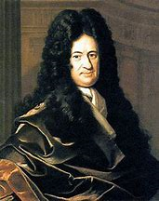
29.11.22 Philosophical responses to the cosmological argument
For it:
Gottfried Leibniz (1646-1716) was a German philosopher and mathematician.
Very well respected thinker.
Leibniz agreed with Aquinas but tried to explain the need for God in the first place. The why question.
He agreed there cannot be infinite regress, because that isn’t a full explanation.
He argued something or someone must have started the world and that there must be some explanation of why there is a world at all. This is known as the:
Principle of sufficient reason. (KU)

Slide 6

The basic idea behind the principle is this:
Take any feature of the world.
If the world could have failed to be that way, then there must be some explanation of why the world is that way.
So, for example, we might notice that although the sky is blue, it might not have been - the sky on earth could have failed to be blue.
Given only this, Leibniz concludes that there must be some reason, or explanation, why the sky is blue: some reason why it is blue rather than some other colour.

Slide 7

Think about what doctors do.
If someone has died and the doctor tells you, "It's because his heart stopped beating," that would be an incomplete explanation.
We want to know why his heart stopped beating.
We want a sufficient explanation. Even if they say "His heart stopped beating because he had a virus," this is also incomplete. We want to know which virus, and why it stopped his heart, and how he caught it.
We want to understand the reason.

Slide 8
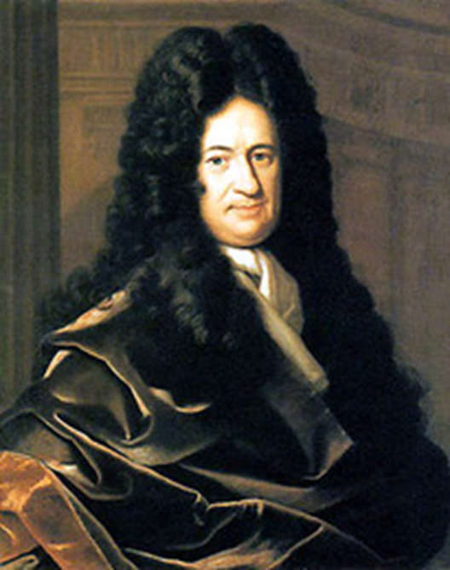
Leibniz is saying that we need the idea of God as an explanation because no other explanation is sufficient to explain the universe. (AN)
Moreover, no other explanation EVER COULD BE sufficient.
Man has not been able to find a reason for the universe's existence within the universe itself – so the great cause must be outside of it.

Slide 9

Gottfried Leibniz: Lets simplify his theory!
Everything has a cause. Think about the jenga blocks moving, a chicken dinner etc. It was caused.
Therefore everything has a reason for its cause. There was a reason the jenga blocks fell, a chicken dinner was made for a reason or purpose.

Slide 10
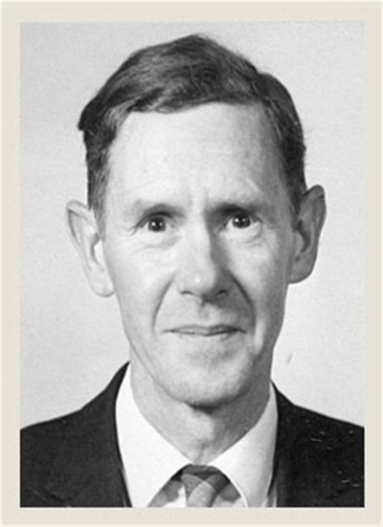


Slide 11

Think of a boxcar train.
Each boxcar is pulled by the one before it, eventually it ends with the engine.
You could not just have an infinite series of moving boxcars, each moving because it is being tugged by the one that comes before it—with no engine. Each car ultimately depends on the behaviour of the first link in the chain, namely, the engine.
Mackie argues that this is the same as the universe.
We can conclude that the universe could not consist of an infinite chain of events with no beginning—no engine if you like. Mackie states that this is proof for the existence of God because everything, train or universe, has to have a first cause.

Slide 12

J.L. Mackie
Mackie argues that God has to be the first cause and therefore is a supporter of the cosmological argument.
He uses the example of a train.
We would not expect a railway train consisting of an infinite number of carriages to move anywhere without an engine. God is like an engine. He is not just another carriage, but the thing that has the power to move without requiring something else to move him (KU)

Slide 13
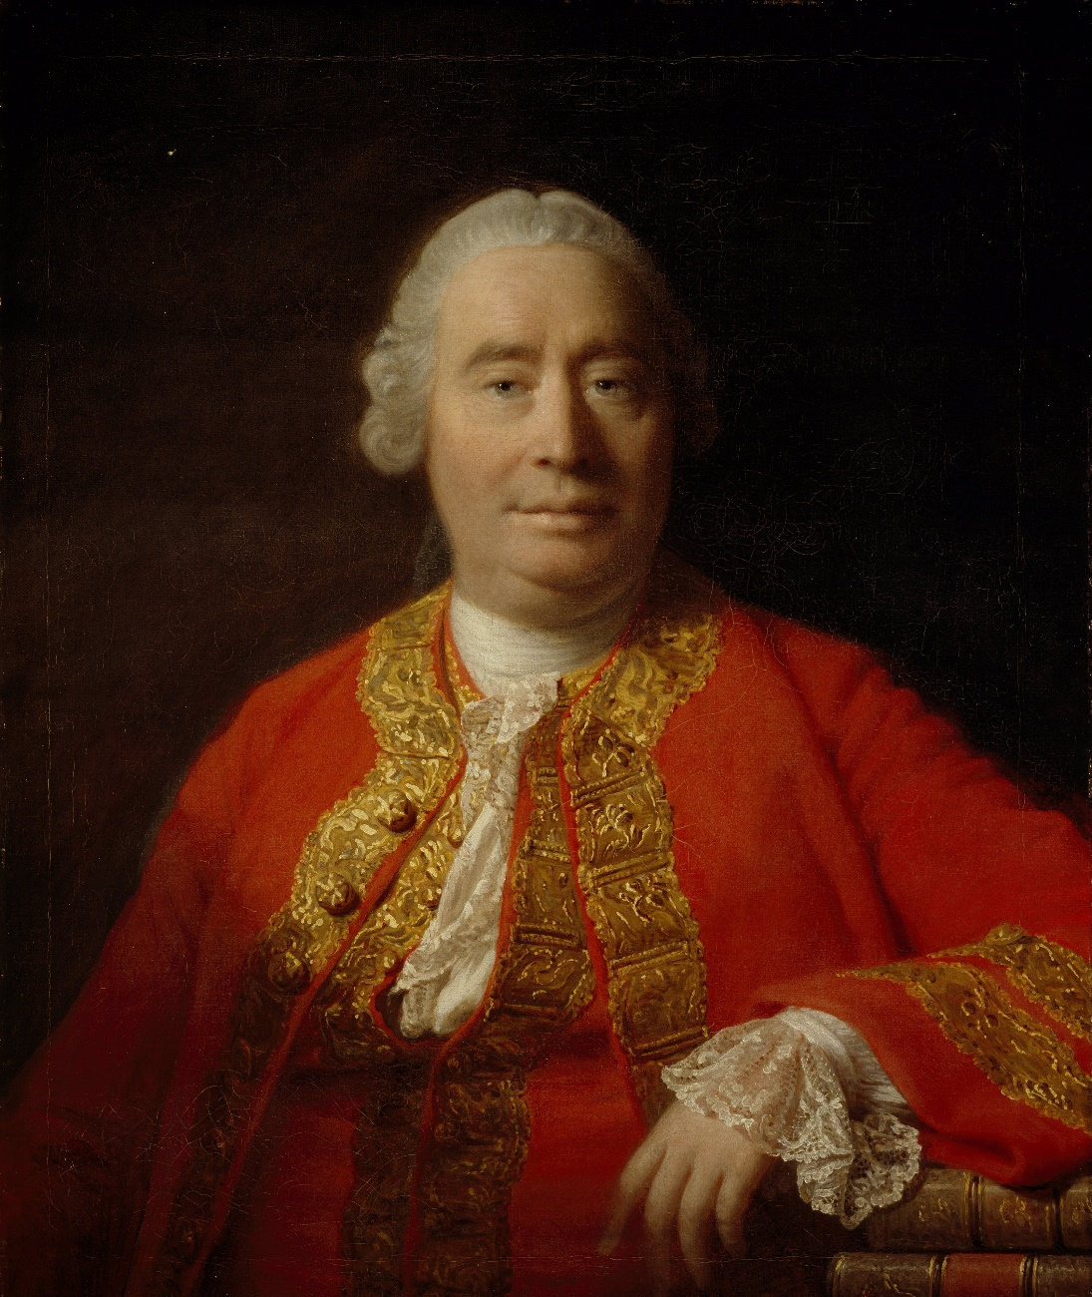


David Hume
Against the Cosmological argument.
Scotsman
Born: 07 May 1711 · Edinburgh, Scotland
Died: 25 Aug 1776 · Edinburgh, Scotland
Education: University of Edinburgh
Philosopher
Agnostic
Empiricist
Notes:
"Away and boil your head!" - which probably won't help you much. What it means is something along the lines of 'Get lost!' or 'Forget it!' - and it's usually said to someone who is deemed to be talking rubbish, or wasting your time.

Slide 14
“A wise man apportions his beliefs to the evidence.”
He said just because everything within the universe has a cause doesn’t mean that the universe itself must have a cause. (KU)
To move from ‘everything that we observe has a cause’ to ‘the universe has a cause’ is too big a leap in logic.

Slide 15
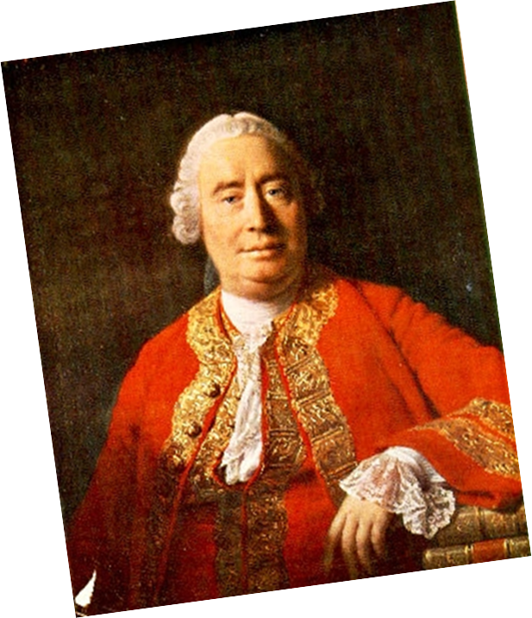
A necessary being is beyond our understanding as we cannot possibly know what qualities a necessary being would have.
If we don’t know what these qualities are then there is no reason to say that only God has them. (KU)
We simply have no idea what qualities this contingent being has. If God exists then what type of God is this. ( good? Bad? Happy? Sad?)
God’s qualities are beyond our conception. Therefore something other than God could have the same qualities. Maybe many God’s or some type of alien being?
Or maybe the Universe is the first cause and had the qualities to create itself.

Slide 16
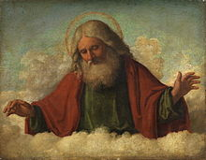
X
Or put another way…
Just because we know that a non-contingent thing is needed to explain the universe doesn’t mean that non-contingent thing has to be God.

Slide 17
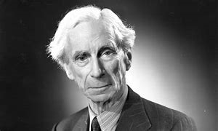

Bertrand Russell (1872-1970) took this argument further by saying that the universe does not need an explanation at all for its existence.
‘I should say that the universe is just there, and that’s all’. (KU)
He said that claiming the universe has a cause just because everything in it has a cause is like claiming that because every human being has one biological mother, the entire human race has one biological mother.

Slide 18

Task:
Create A5 revision notes on these 4 philosophers.
Make sure you include:
The correct spelling of their name!
Whether they were for or against the cosmological argument.
Two key points they would say in response to it.
Your evaluation of their opinion. Do you agree with it or not? What are the weaknesses or flaws in their argument? What are the strengths?

